Slide 1
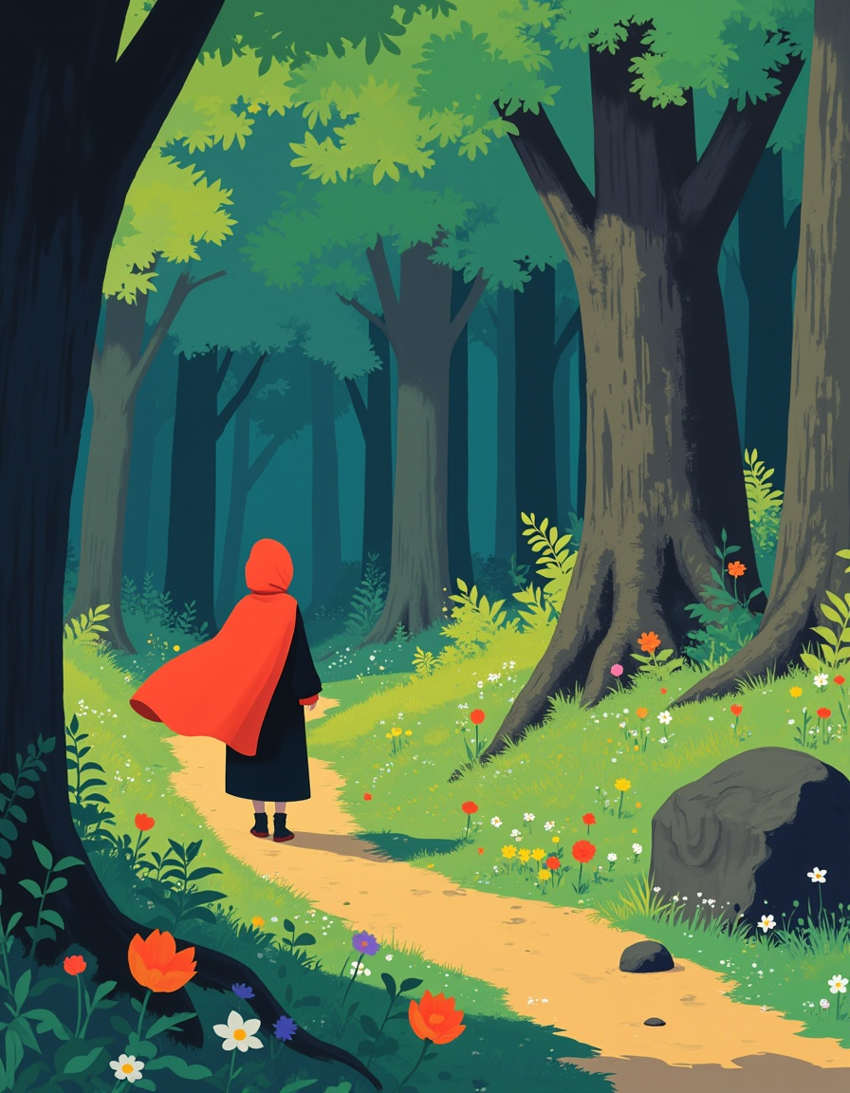
Classic tales by the Grimm Brothers

Slide 2
Index
01
02
03
Biography
Their most famous stories
Activities

Slide 3
01
Biography

Slide 4
Getting to know the Brothers Grimm
Jacob Ludwig Karl Grimm was born in 1785 and Wilhelm Kart Grimm in 1786, both in Hanau
They are famous for their hundreds of children’s stories and also for
their “German Legends.” At the age of 20, Jacob supported himself with his salary as a librarian, and Wilhelm worked as the library secretary
By the time they were 30, they had achieved an outstanding reputation through numerous publications. Their stories emerged from collecting ancient tales passed down orally

Slide 5
The truth about the tales of the
Brothers Grimm
The content is quite macabre, especially when compared to the versions we know
Readers familiar with these stories can compare both versions and see how the original was aimed more at an adult audience. Undoubtedly, adults used these stories as examples, using
behaviours deemed condemnable by any society to represent evil, punishment, and cruelty.
Over time, these stories became acceptable for teaching values to children, but they had to be adapted to make them suitable for young audiences

Slide 6
Fairy tales
Most of the stories had something in common: fairies.
In 1812, the Grimm brothers published the first volume of Children’s and Household Tales, in which they compiled their collection of stories

Slide 7
02
Their most famous stories

Slide 8
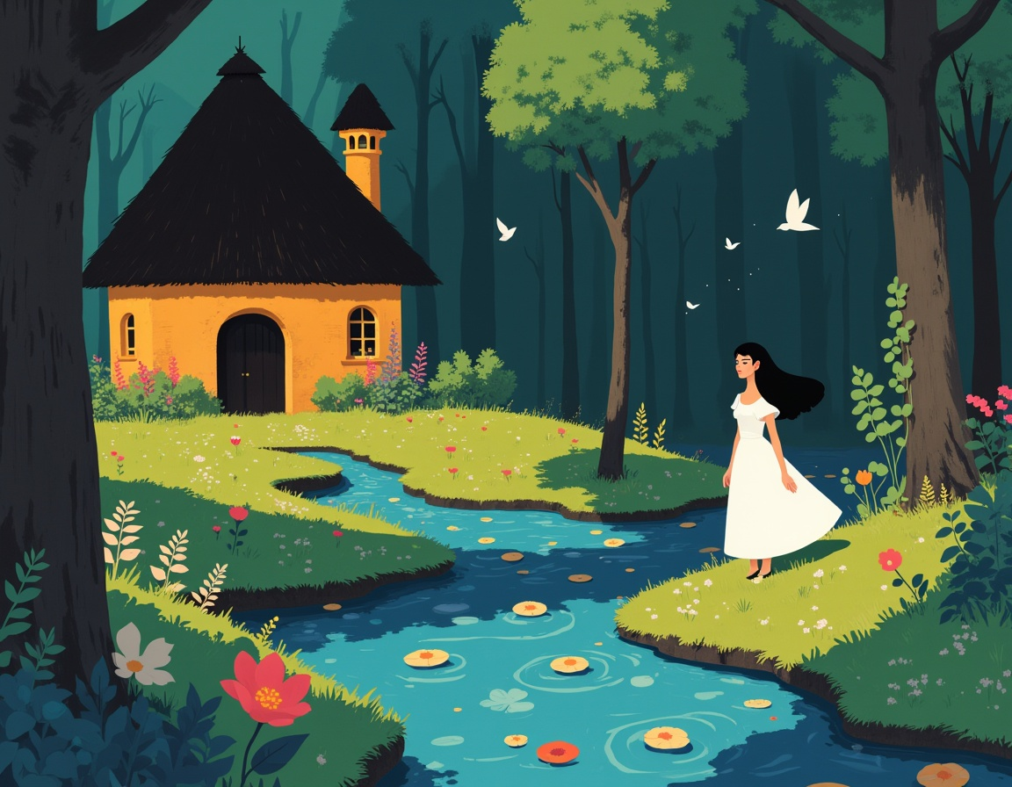
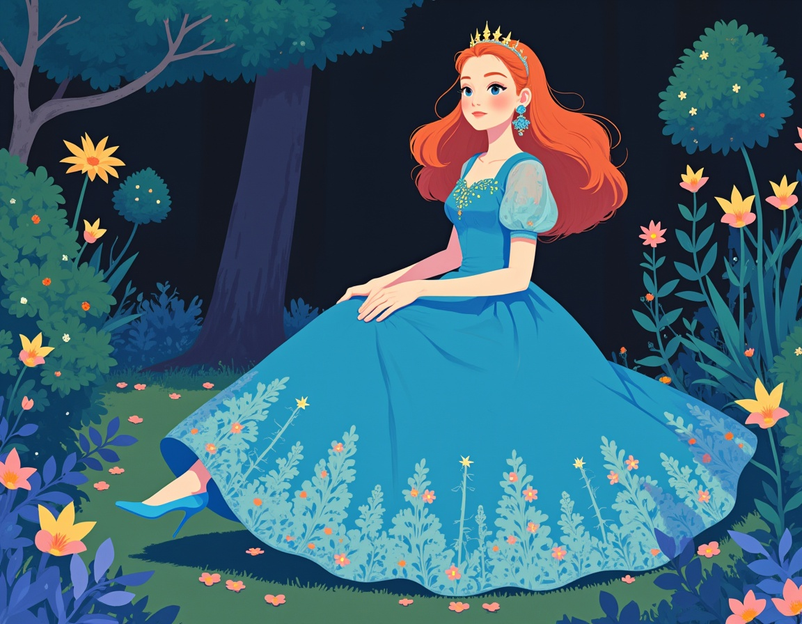
Famous stories
Snow White
Cinderella

Slide 9
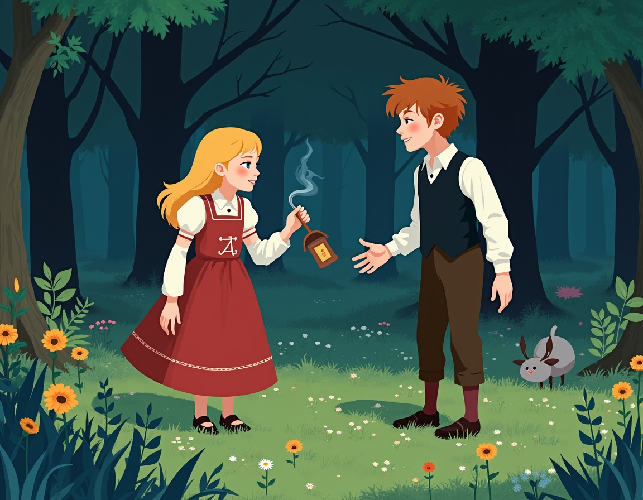
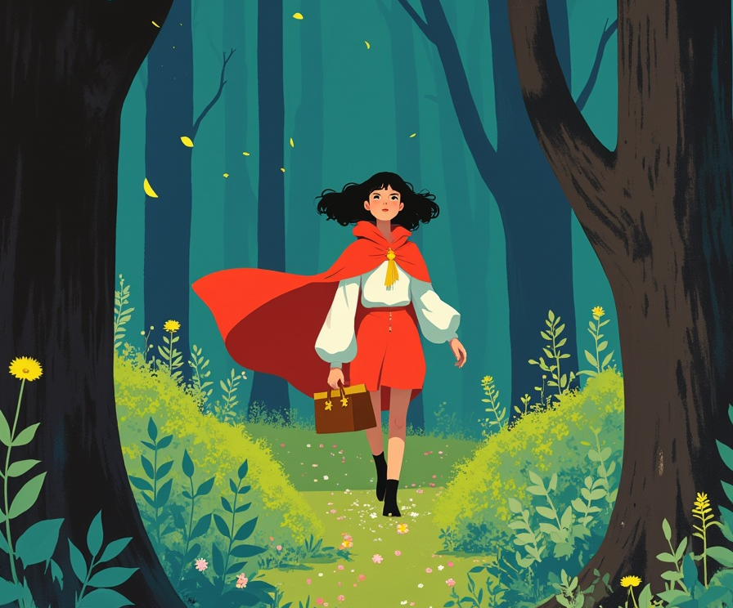
Famous stories
Hansel and Gretel
Little Red Riding Hood

Slide 10
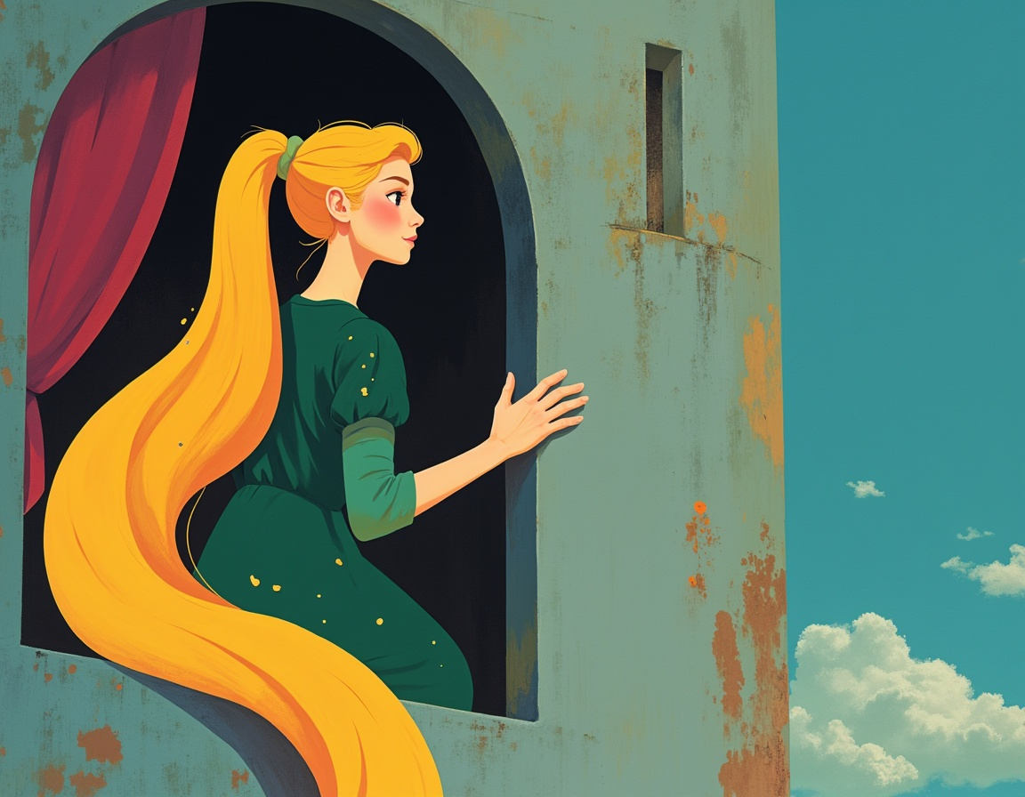
Famous stories
Rapunzel

Slide 11
03
Activities

Slide 12
Change the ending of the tale of Snow White

Slide 13
True or false Hansel and Gretel
T
F
Hansel and Gretel go to their house
Hansel and Gretel find a paper house
The boy and girl feel very sad

Slide 14
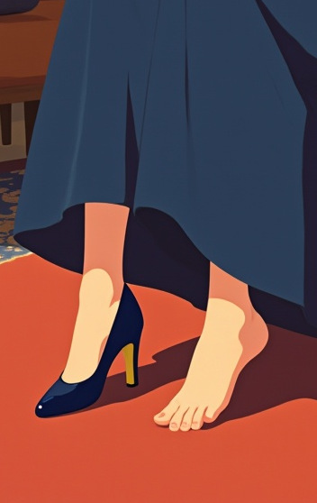
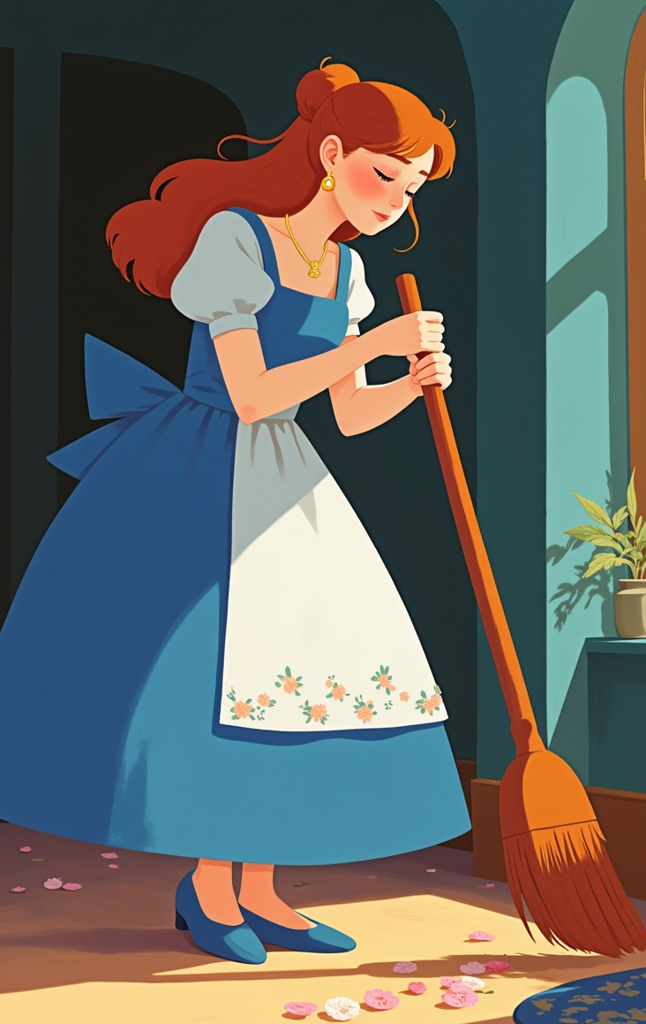
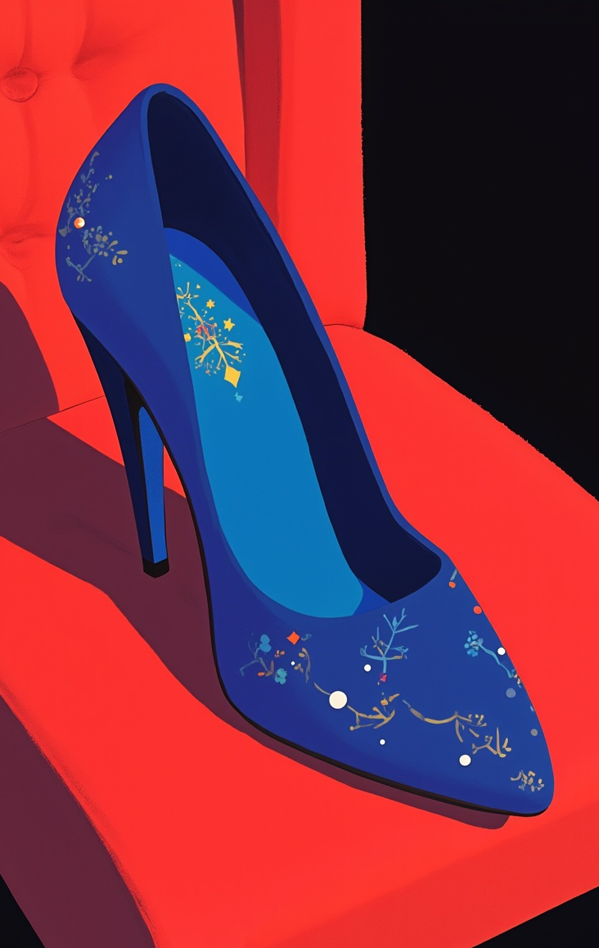
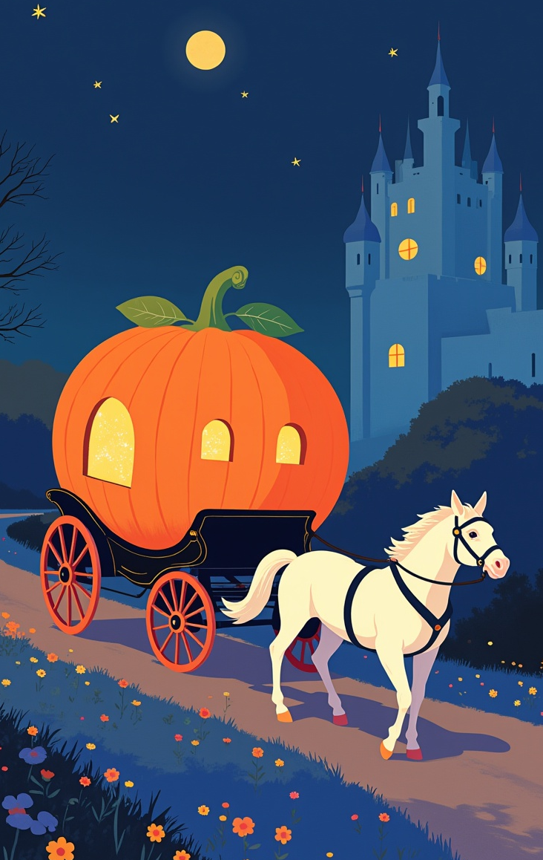
Sequence: Cinderella
Order the sequence of the tale Cinderella

Slide 15
Little Red Riding Hood throughout the tale
Describe the emotions Little Red Riding Hood experienced and in which situations throughout the story
Happiness
Sadness
Anger
Fear
Surprise

Slide 16
Change any of the characters from Rapunzel

Slide 17
Thanks!
Do you have any questions?
youremail@freepik.com
+34 654 321 432
yourwebsite.com
Please keep this slide for attribution

Slide 18
Alternative resources
Here’s an assortment of alternative resources whose style fits that of this template:
Illustrations
Flat design enchanted forest illustration

